Slide 1
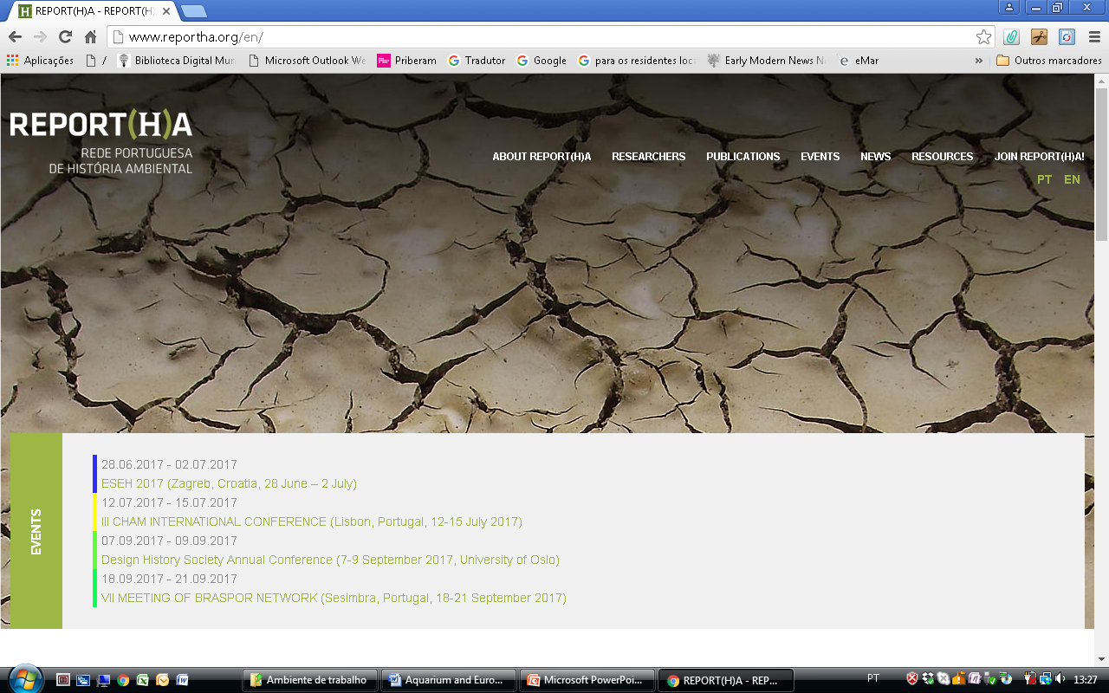
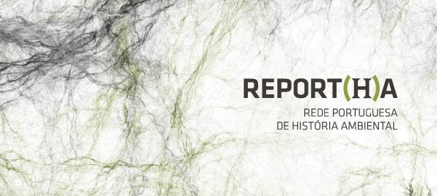
Report(h)a’s website – operation, access and impact
www.reportha.org

Slide 2
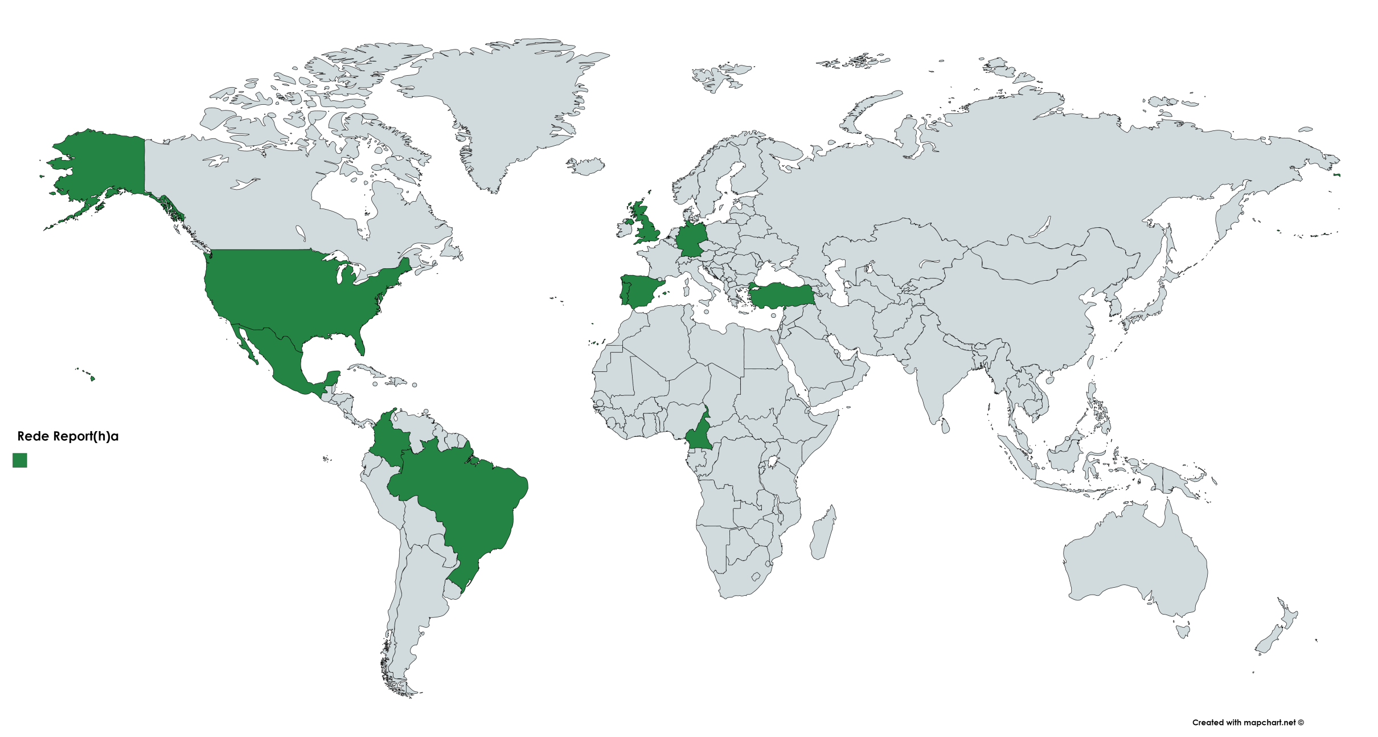
Report(h)a network (researchers registered until 2017)
Almost 130 researchers

Slide 3
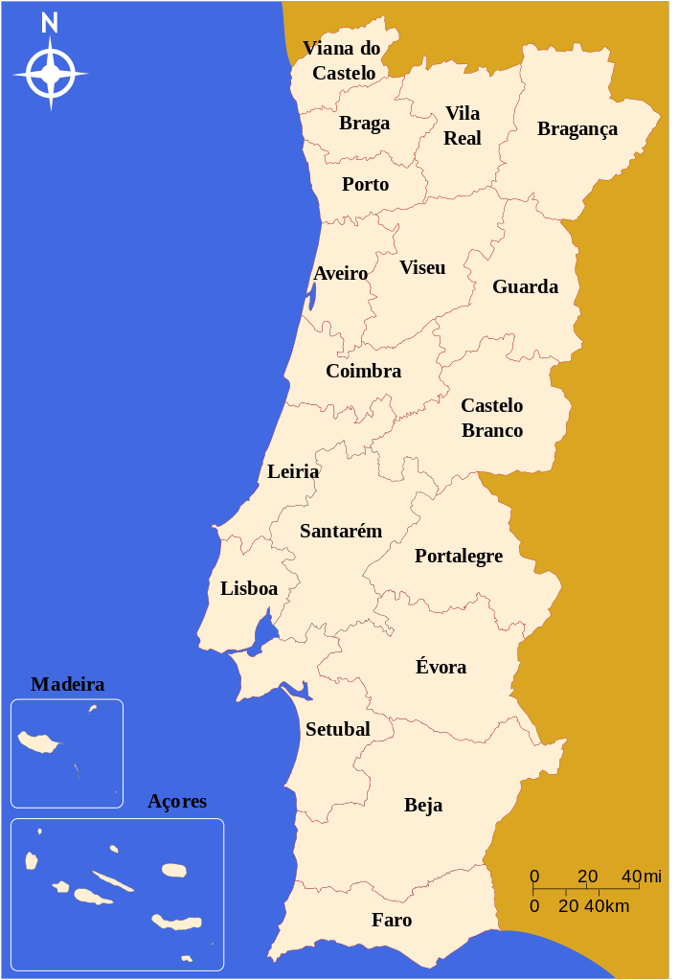
Portuguese researchers:

Slide 5
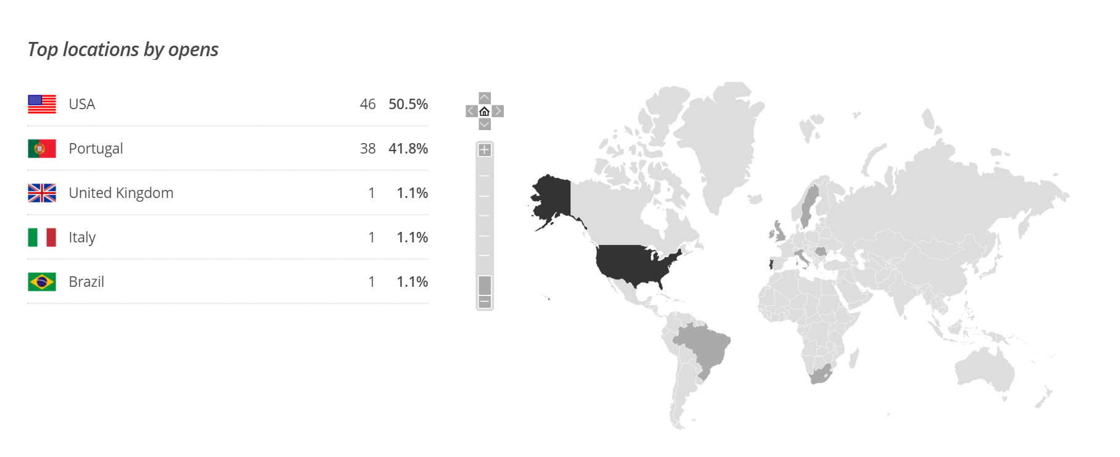
Reporth(h)a newsletter subscribers:
182 subscribers

Slide 6
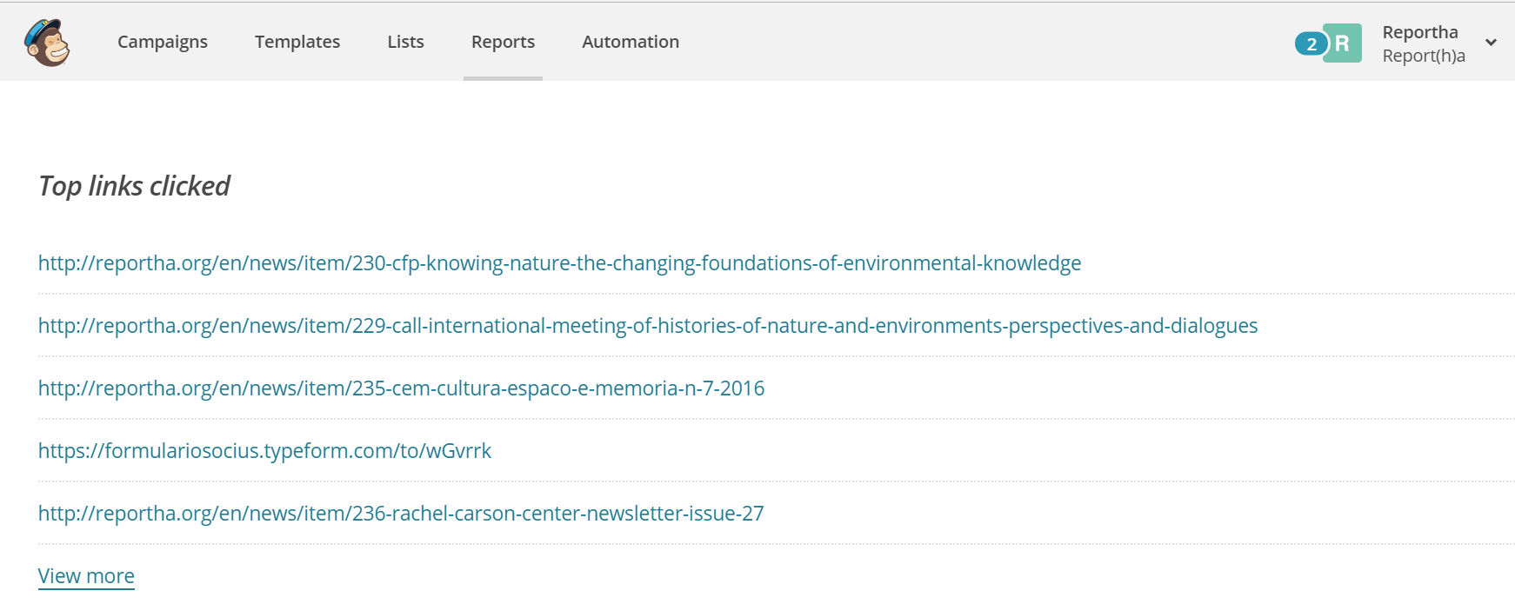
Most popular links:
Sara Pinto, Pos-Doc; Luís Pedro, PhD student CITCEM/FLUP

